Slide 1
Create a github: https://github.com/chenzcv/DGNN
Survey on DGNN datasets: Wikipedia, Reddit, MOOC, LastFM
Re-run the TGN with datasets above
Re-run the TGN with different batch size ([10, 50, 100, 200, 400, 500, 1000, 2000, 4000])

Slide 2
Dataset | Users | Items | Interactions
Wikipedia | 8227 | 1000 | 157474
Reddit | 10000 | 984 | 672447
MOOC | 7047 | 97 | 411749
LastFM | 980 | 1000 | 1293103
Reddit
this public dataset consists of one month of posts made by users on subreddits. We selected the 1,000 most active subreddits as items and the 10,000 most active users. This results in 672,447 interactions.
Wikipedia
this public dataset is one month of edits made by edits on Wikipedia pages. We selected the 1,000 most edited pages as items and editors who made at least 5 edits as users (a total of 8,227 users). This generates 157,474 interactions.
this public dataset has one month of wholistens-to-which song information. We selected all 1000 users and the 1000 most listened songs resulting in 1,293,103 interactions.
LastFM
this public dataset consists of actions done by studentson a MOOC online course. This dataset consists of 7,047 users interacting with 98 items (videos, answers, etc.) resulting in over 411,749 interactions
MOOC

Slide 3
Reddit
Reference: Reddit data dump. http://files.pushshift.io/reddit/.
Dataset: http://snap.stanford.edu/jodie/reddit.csv
Wikipedia
Reference: Wikipedia edit history dump. https://meta.wikimedia.org/wiki/Data_dumps
Dataset: http://snap.stanford.edu/jodie/wikipedia.csv
LastFM
Reference: B. Hidasi and D. Tikk. Fast als-based tensor factorization for context-aware recommendation from implicit feedback. In ECML, 2012
Dataset: http://snap.stanford.edu/jodie/lastfm.csv
MOOC
Reference: T. R. Liyanagunawardena, A. A. Adams, and S. A. Williams. Moocs: A systematic study of the published literature 2008-2012. The International Review of Research in Open and Distributed Learning, 14(3):202–227, 2013 Dataset: http://snap.stanford.edu/jodie/mooc.csv

Slide 4
Dataset | Test AP (Transductive) | Test AP (Inductive)
Wikipedia | 0.9846 | 0.9781
Reddit | 0.9869 | 0.9743
MOOC | 0.9055 | 0.8953
LastFM | 0.7849 | 0.7255

Slide 5
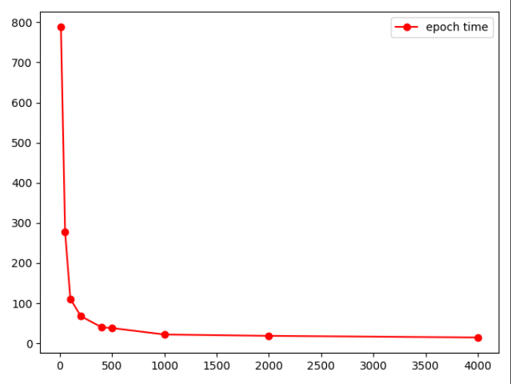
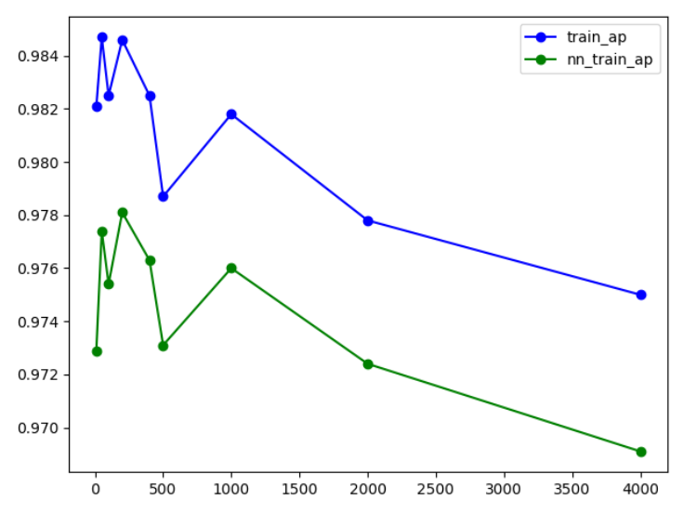
bs | 10 | 50 | 100 | 200 | 400 | 500 | 1000 | 2000 | 4000
Epoch time | 788.04 | 278.00 | 110.89 | 62.72 | 39.84 | 37.98 | 21.94 | 18.55 | 14.50
AP (Transductive) | 0.9821 | 0.9847 | 0.9825 | 0.9846 | 0.9825 | 0.9787 | 0.9818 | 0.9778 | 0.9750
AP (Inductive) | 0.9729 | 0.9774 | 0.9754 | 0.9781 | 0.9763 | 0.9731 | 0.9760 | 0.9724 | 0.9691

